Slide 1
Clean Code Highlights

Slide 2
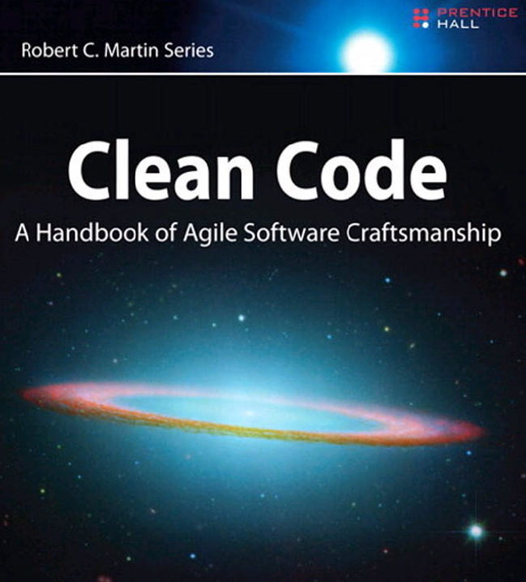
About this chapter
This chapter captures the essence of the Clean Code book by Robert C. Martin.
This chapter summarizes the key recommendations and adds some extra observations, hints, and tips.

Slide 3
Contents
General recommendations and principles
Choosing meaningful names
Functions
Comments
Formatting
Error handling
Boundaries

Slide 4
1. General Recommendations and Principles
General recommendations
Key principles

Slide 5
General Recommendations
Focus - do one thing well
Have minimal dependencies, explicitly defined
You must have tests
Avoid duplication
Be attentive and love your code (read:write ratio is 10:1)
Choose meaningful names

Slide 6
Key Principles
Single Responsibility Principle
Open/Closed Principle
Dependency Inversion Principle
Command/Query Responsibility Separation

Slide 7
2. Choosing Meaningful Names
General naming recommendations
Make your intent clear
Additional specific suggestions

Slide 8
General Naming Recommendations
Avoid single-letter names (hard to search for)
What about loop counters?
What about lambda parameters?
Be consistent about naming things
E.g. is it a Customer, or a Member, or a User?
Don't be overly restrictive with names
E.g. accounts is better than accountList

Slide 9
Make Your Intent Clear
Don't be afraid of long, descriptive names
They reveal intent, and help you to avoid comments
E.g. see some of the class names in Spring Framework
Use standard industry names
You can assume developers understand the domain language
Use well-known pattern names
E.g. XxxVisitor, XxxAdapter, XxxComposite

Slide 10
Additional Specific Suggestions
Avoid magic numbers
Introduce well-named methods to encapsulate tricky or opaque details in algorithms
Don't use encodings for names
E.g. Hungarian Notation - not needed these days (why not?)
E.g. C prefix for classes, I prefix for interfaces (why not?)

Slide 11
3. Functions
General function recommendations
Naming functions
Function arguments
Function return values

Slide 12
General Function Recommendations
Functions should have a single purpose
Either a command or a query, but not both
Functions should be really small
Maximum 1 or 2 levels of indentation (if you need more levels of indentation, refactor into a separate function)
What are the benefits of this?
Don't have separate 'sections' of a function
Split into separate functions
What are the benefits of this?
Don’t repeat yourself
I said, "Don't repeat yourself"

Slide 13
Naming Functions
Long names are fine
Command method names should be verbs
Use a consistent lexicon
E.g. add() and remove()
Standard naming of helper classes- what role do they fulfil
getXxx() or isXxx()
setXxx()

Slide 14
Function Arguments
1-arg functions
Testing something about a value
Transforming a value and returning the result
2-arg functions
Not as good as 1-arg functions…
Might not be clear what the args mean, or the order
Generally:
Avoid more-than-2-args if possible (consider wrapping as object)
Avoid passing null if possible (think about implications for the func)
Avoid output args
Avoid boolean 'flag' args

Slide 15
Function Return Values
It's OK to have multiple return statements
This seems to violate lots of "good advice"
So why do we say it here…?
Prefer a return value to an output argument
Easier to understand, fewer surprises for the developer
Generally:
Avoid returning null if possible (think about implications for caller)
Throw an exception rather than returning an error code

Slide 16
4. Comments
General comments recommendations
When are comments justifiable?
When are comments definitely not justifiable?

Slide 17
General Comments Recommendations
Comments are always failures
If you think you need a comment, consider how you can refactor your code to avoid it
For example…?
What's so bad about comments?
They lie (eventually)
They are a waste of time to write
They are worse than a waste of time to read
They aren't enforced by the compiler
They can become detached from the original code

Slide 18
When are Comments Justifiable?
To describe complicated regular expressions
To describe non-obvious business rules
To describe 3rd-party code (which you can't refactor)
To stop a maintenance developer doing something stupid
TODO comments
In Java, add JavaDocs for public APIs

Slide 19
When are Comments Definitely Not Justifiable?
Journal comments
Version Control Systems can do this perfectly well already
Noise comments decorating every function or variable
It gets in the way when trying to read the code
Implementation-explanation comments
Refactor the code instead
E.g. split a complicated algorithm into multiple steps
E.g. encapsulate bits in a separate function
E.g. use named constants

Slide 20
5. Formatting
General formatting recommendations
Specific formatting suggestions

Slide 21
General Formatting Recommendations
Consistent formatting across the team
Small files are easier to understand than large files
Organise code like in a newspaper
Headlines - explain gist (i.e. file name)
Top few paragraphs give important info (i.e. first few functions)
Lower sections give less important info (i.e. latter functions)
Use of blank lines is important
Things that belong together should be vertically adjacent
Things that are different should be separated by a blank line

Slide 22
Specific Formatting Suggestions
Variables
Declare at the start of a function, or just at the point of first use?
Functions
High-level functions before low-level functions
Where do you put private functions?
Horizontal spacing
Put spaces around binary operators
Don't put spaces around unary operators
Don't put spaces before function parens
Put space before if/for/etc parens

Slide 23
When are Comments Definitely Not Justifiable?
Journal comments
Version Control Systems can do this perfectly well already
Noise comments decorating every function or variable
It gets in the way when trying to read the code
Implementation-explanation comments
Refactor the code instead
E.g. split a complicated algorithm into multiple steps
E.g. encapsulate bits in a separate function
E.g. use named constants

Slide 24
6. Error Handling
General error handling recommendations
Specific exception suggestions

Slide 25
General Error-Handling Recommendations
Prefer exceptions to error codes
Easier for client code to manage, i.e to keep normal flow separate from exceptional flow
Only use exceptions for exceptional conditions
E.g. it might be OK to do nothing, or return 0, or something
Provide meaningful context info in an exception
E.g. the message in a Java/.NET exception
Always log exceptions
Provides vital information when operational failures occur

Slide 26
Specific Exception Suggestions
Use unchecked exceptions rather than checked exceptions
Checked exceptions cause too much noise (other languages, e.g. C#, C++, Python) manage fine without checked exceptions
Checked exceptions violate the Open/Closed Principle (i.e. open for extension, closed for modification) because if you throw a checked exception at a low-level, you must add a throws to calling funcs
Exception patterns to consider:
Catch exceptions as locally as possible, i.e. layering
Wrap technical exceptions with domain-specific exceptions
Catch-and-rethrow

Slide 27
2. Exception Handling Best Practice
Refactoring duplicate catch code
The need for exception-safe code
A manual approach to exception-safe code
The copy-before-release idiom
The execute-around idiom

Slide 28
Refactoring Duplicate Catch Code
It's common for several catch handlers to have some duplicate exception-handling logic
Leads to code duplication in the catch blocks – eek
You can define a helper function that performs the common behaviour and then re-throws the exception
Specific catch handlers can then perform additional handling
try
{
// whatever …
}
catch (...)
{
handle_exception();
}
void handle_exception()
{
try
{
… … … // Put common catch code here.
throw; // Then re-throw the exception.
}
catch (SomeSpecificException1 & ex)
{
// Specific catch logic here.
}
catch (SomeSpecificException2 & ex)
{
// Other specific catch logic here.
}
}

Slide 29
The Need for Exception-Safe Code
Exception safety is critical
Make sure you don't have dangling pointers due to an unexpected exception truncating your logic
E.g. what would happen if an exception occurred where indicated in the following handle-body code?
class handle
{
private:
class body;
body *self;
public:
handle &operator=(const handle & rhs)
{
if (this != &rhs)
{
delete self;
self = new body(*rhs.self); // What if an exception occurred here?
}
return *this;
}
…
};

Slide 30
A Manual Approach to Exception-Safe Code
Here's a (rather clumsy) approach to achieve exception-safe code
It does work…
But it's painful to write code like this (and to get it right!)
handle &handle::operator=(const handle &rhs)
{
if(this != &rhs)
{
body *old_self = self;
try
{
self = new body(*rhs.self);
delete old_self;
}
catch(...)
{
self = old_self;
throw;
}
}
return *this;
}

Slide 31
The Copy-Before-Release Idiom
Here's a refactored version of the code
Better…
We ensure the object is always in a stable state, so we don't need to undo any state changes that might have gone pear-shaped
handle &handle::operator=(const handle &rhs)
{
body *old_self = self;
self = new body(*rhs.self);
delete old_self;
return *this;
}

Slide 32
The Execute-Around Idiom
The execute-around idiom is an example of "resource acquisition is initialization", a.k.a. RAII
We'll take a closer look at this later in the course
The basic idea is to create a local object whose destructor absolutely ensures resources are released properly, even in the event of an exception
{
some_wrapper_type wrapper(some_resource);
// Use some_resource object here
} // Destructor for wrapper object is called here,
// will ensure some_resource is released deterministically.

Slide 33
7. Using Third-Party APIs
General recommendations
Learning and testing third-party APIs

Slide 34
General Recommendations
When using a 3rd-party API, consider wrapping API in your own adapter class
Encapsulates the dependency in one place
Protects the rest of the system from evolution of the 3rd-party API, so your system is more stable
This is the Adapter Pattern
You can define an adapter interface for an API that maybe doesn't exist yet
Enables you to write the rest of the system, without having to wait for the API to be available
You should define your interface in terms of the functions you need out of the API, then later on you can figure out how to achieve these capabilities when the API becomes available

Slide 35
Learning and Testing Third-Party APIs
Learning 3rd-party APIs can be tricky
You don't really want to be goind through the learning curve while implementing production code
Instead, consider writing "learning" tests to help you figure out how it all hangs together
Keep these "learning" tests, they'll help you do regression tests if a new version of the API is released in future
When testing your real code, be careful not to test the 3rd-party functionality
You have to assume it works!

Slide 36
Any Questions?

